Slide 1

Enhancing R Programming with GitHub Copilot and chattr package in R-Studio
AI Overloading
by Sergio A. Sabat-Bonilla
Made by ChatGPT-4

Slide 2

Introduction: The Rise of AI in Coding
Rapid Development: AI enhances coding processes and maintenance.
Enhanced Efficiency: Tools like GitHub Copilot streamline routine tasks.
Improved Code Quality: AI suggests code optimizations and best practices.
Accessibility and Learning: AI aids beginners and enhances codebase comprehension.
Made by ChatGPT-4
Notes:
Rapid Development: AI integration into development environments has transformed how code is written, debugged, and maintained.
Enhanced Efficiency: AI-driven tools like GitHub Copilot reduce the time spent on routine coding tasks, allowing developers to focus on more complex and creative aspects of programming.
Improved Code Quality: AI can analyze vast amounts of code to suggest optimizations and best practices, leading to improved code quality and performance.
Accessibility and Learning: These tools make coding more accessible to beginners by providing real-time suggestions and examples. They also serve as learning aids, helping programmers understand new codebases and languages quickly.

Slide 3

Importance and Benefits for R Programmers
Rapid Data Analysis: AI accelerates complex data script writing.
Enhanced Productivity: AI reduces script writing and debugging time.
Customized Code Assistance: AI tailors suggestions to coding styles and project needs.
Error Reduction: AI identifies and fixes errors, enhancing code accuracy.
Made by ChatGPT-4
Notes:
Rapid Data Analysis: R is extensively used for data analysis, statistics, and graphical models. AI tools can speed up the writing of complex data manipulation and analysis scripts, making it easier for R programmers to handle large datasets.
Enhanced Productivity: AI suggestions for R code can significantly reduce the time taken to write and debug scripts. This is especially beneficial in R's use for statistical modeling, where fine-tuning models can be time-consuming.
Customized Code Assistance: AI tools can learn from the specific coding style and requirements of a project. For R programmers, this means getting relevant suggestions that align with their data analysis or research needs.
Error Reduction: AI assistance helps in identifying and rectifying potential errors or inefficiencies in R code, which is crucial in ensuring the accuracy of data analysis and research outcomes.

Slide 4
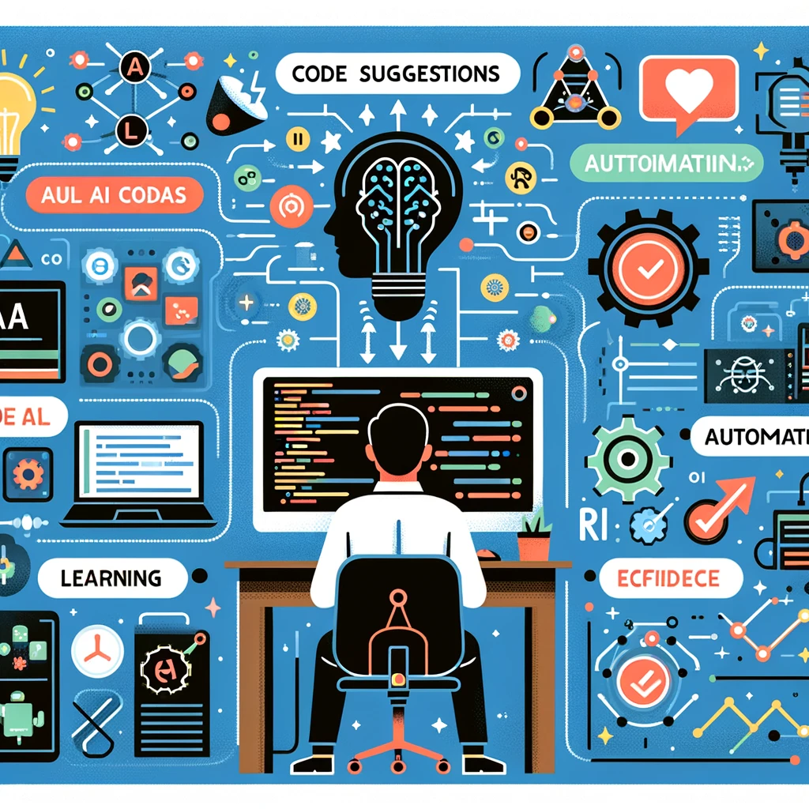
AI Overlord Options for R Users
ChatGPT 3.5 in web browser is free
ChatGPT 3.5 in GitHub Copilot + R-Studio integration is $10/month
chattr package is free and integrated into R-Studio
uses ChatGPT3.5 + other AI dialogs
Made by ChatGPT-4

Slide 5

Overview of GitHub Copilot
AI-powered code completion tool developed by GitHub and OpenAI, designed to assist programmers by suggesting code snippets in real-time.
Acts like a collaborator that helps write code, tests, and even complex algorithms, learning from the programmer's style and the context provided by the existing code.
Made by ChatGPT-4

Slide 6
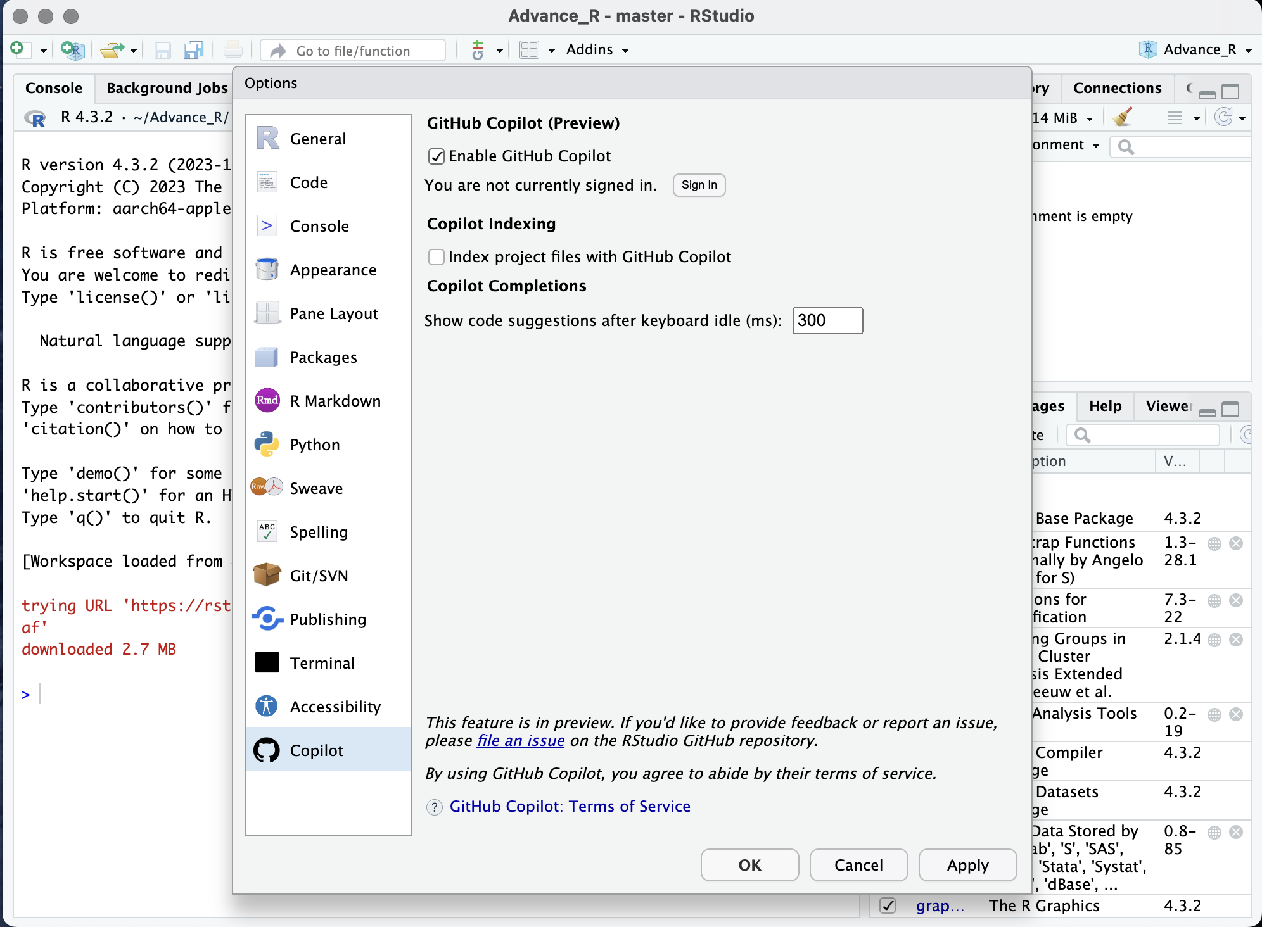
Integrating GitHub Copilot with R-Studio
*Once you have subscribed to GitHub Copilot
To Enable GitHub Copilot in RStudio:
1) Navigate to Tools > Global Options > Copilot.
2) Check the box to “Enable GitHub Copilot”.
3) Download and install the Copilot Agent components.
4) Click the “Sign In” button.
5) In the “GitHub Copilot: Sign in” dialog, copy the Verification Code.
Notes:
Predicting your next move

Slide 7
chattr: ChatGPT integration in R-Studio
Seamlessly integrates advanced AI capabilities into the R programming workflow, enhancing productivity and ensuring the use of robust coding practices
Notes:
Aiding you in your next move

Slide 8
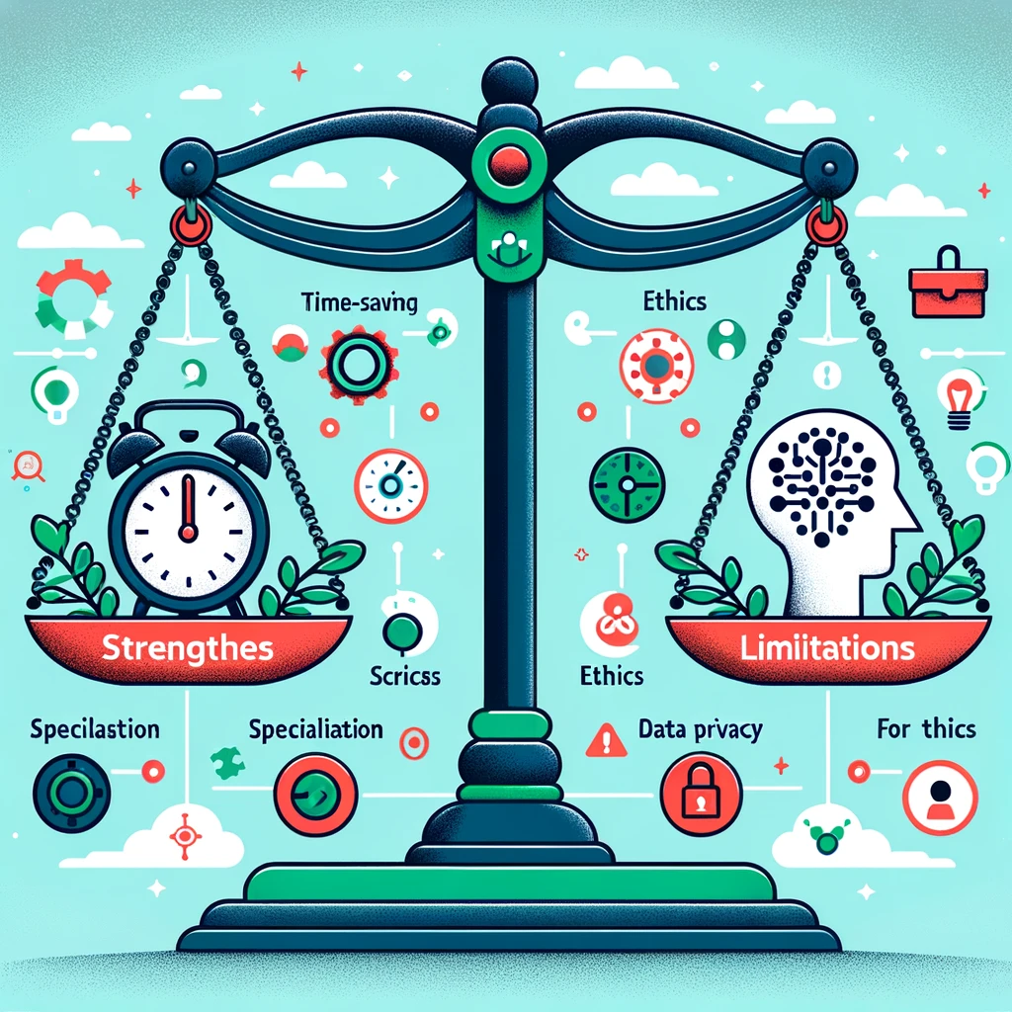
Strengths Limitations
Reduces coding time for routine tasks.
Automates repetitive coding, improving focus on complex problems.
Proficient in generating complex code patterns.
Enhances code quality with best practice suggestions.
Less effective in highly specialized or niche domains.
Potential ethical issues regarding code originality.
Data privacy concerns with AI learning from extensive codebases.
Made by ChatGPT-4

